Slide 1
MEG & DTI Connectomes

Slide 2
Data processing
Participant level:
Structual data (Danyal’s DTI connectomes) CSA streamline count ROIs
Group level:
68x68x147 Participant data matrix
GLM with Age and IQ (WASI Matrix) added
Permutation testing on predictors

Slide 3
Results: MRI Intercept

Slide 4
Results: MRI Age

Slide 5
Results: MRI Age

Slide 6
Data processing
Participant level:
Resting state data – continuous
Source Reconstructed using MNE cortical estimation
Time course extracted from 68 cortical parcellations
Fitted to MVAR model (gives directed connectivity metrics at frequencies)
68x68xfreq partial directed coherence matrix generated
Group level:
68x68x147 Participant data matrix
GLM with Age and IQ (WASI Matrix) added
Permutation testing on predictors
Surrogate permutation testing on intercept (phase shuffling of data)

Slide 7
Mulivariate (vector) Autoregressive Models
For each timepoint and sensor, the model is based on a linear combination of previous timepoints and sensors.
Therefore activity in sensor A can be explained as a linear combination of its own activity and activity of sensors A-Z
We give the model an order, higher number = more complicated fitting.
We can extract transfer metrics from this model (Direct Transfer Function or Partial Directed Coherence). Explains what proportion of activity is explained by other sensors, and what proportion of other sensors it explains.

Slide 8
MVAR Modes/delays
The number of modes specifies how many delays

Slide 9
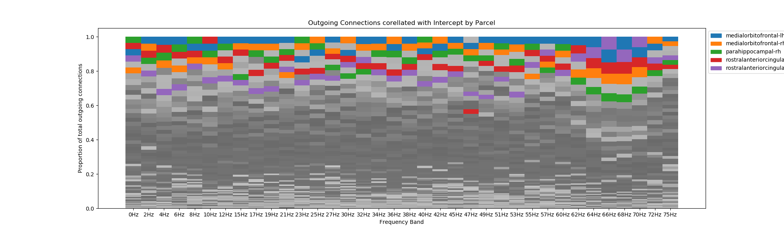
Results: Intercept -Outgoing

Slide 10
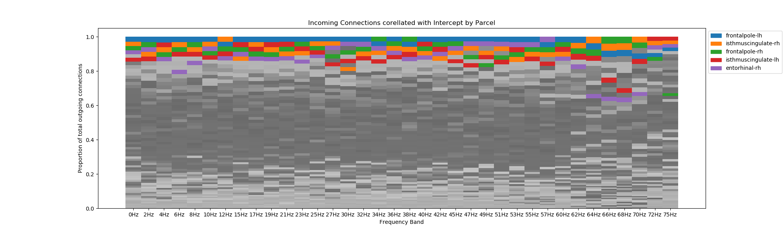
Results: Intercept -Incoming

Slide 11
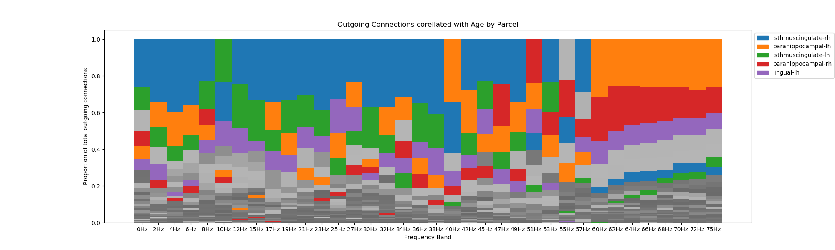
Results: Age -Outgoing
WHAT? medial areas seem to account for 60% of Outgoing connections related to age??

Slide 12
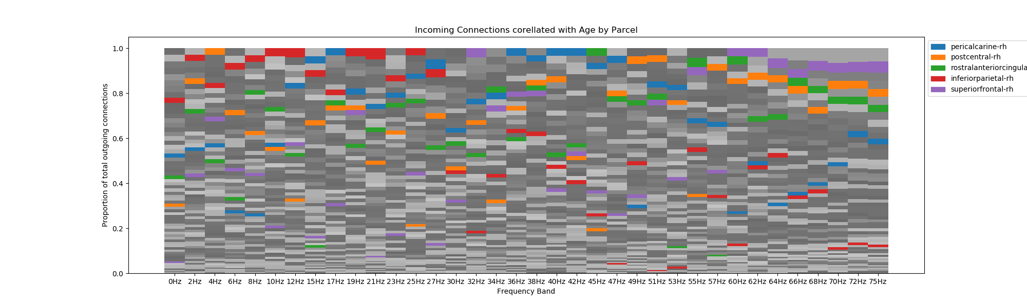
Results: Age -Incoming

Slide 13
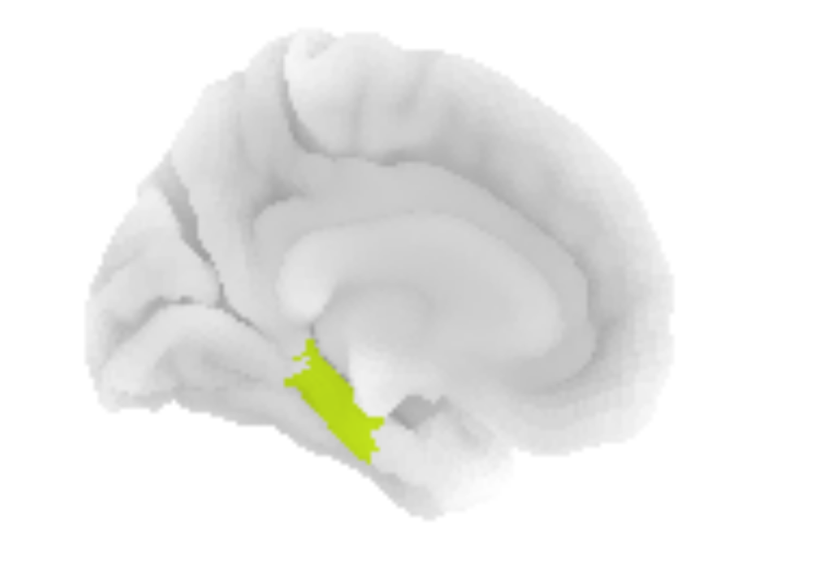
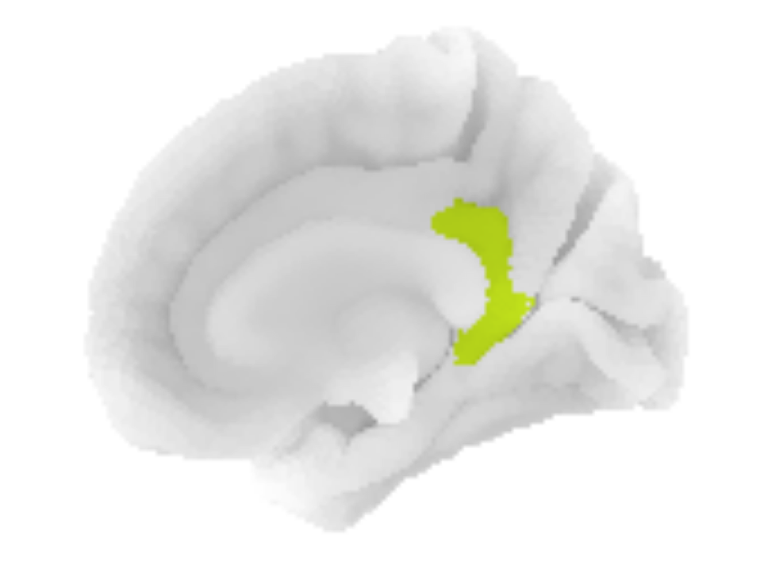
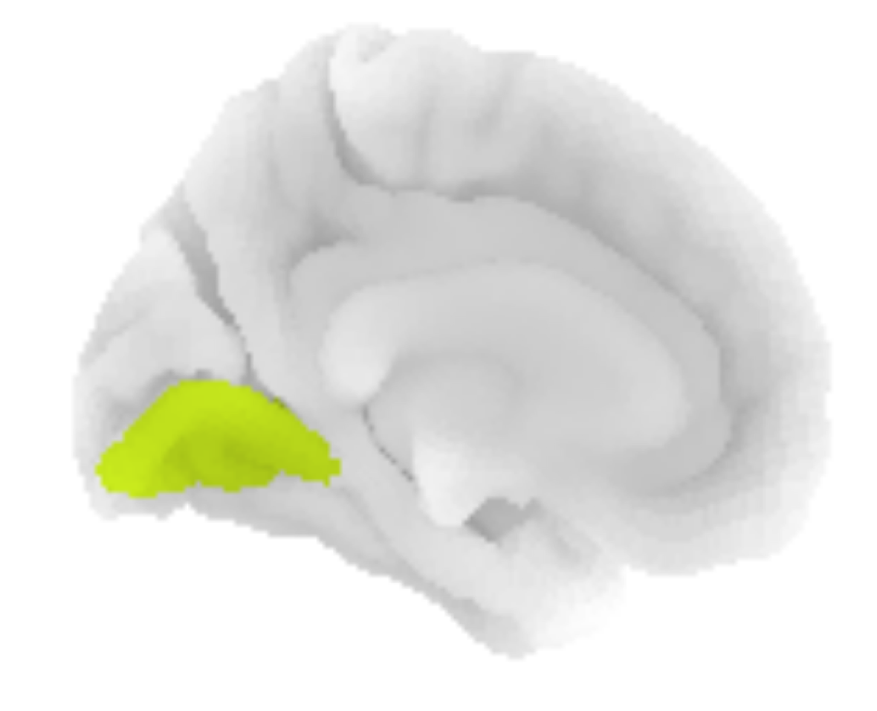
Results: Age –Outgoing -- what??

Slide 14
Results: IQ -Outgoing
Again, central brain areas?

Slide 15
Results: IQ -Incoming

Slide 16
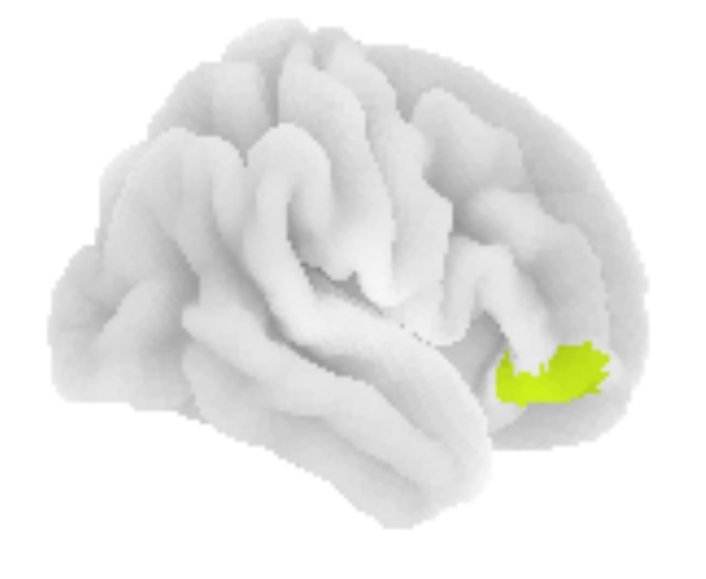
Results: IQ –Outgoing

